Slide 1
Session #9:
Temporal Difference Learning
Notes:
Welcome to the course !!!
The idea that we learn by interacting with our environment is probably the first to occur to us when we think about the nature of learning. When an infant plays, waves its arms, or looks about, it has no explicit teacher, but it does have a direct sensorimotor connection to its environment.
Whether we are learning to drive a car or to hold a conversation, we are acutely aware of how our environment responds to what we do, and we seek to influence what happens through our behavior.
Learning from interaction is a foundational idea underlying nearly all theories of learning and intelligence. We will take a computational approach to learning from interaction.
The specific approach which we use to learn from the environment, which we call as reinforcement learning, is much more focused on goal-directed learning from interaction than are other approaches to machine learning.
In this course, we will look into various kind of experimental setups modelling the agent-environment interaction towards performing goal oriented learning. We will start with very basics, and an elementary model.
This course is a core course for all of you. This course will be taught by myself and Dr. Sangeetha Viswanathan.

Slide 2
Agenda for the class
Temporal Difference Learning
TD(0)
SARSA
Q-Learning

Slide 3


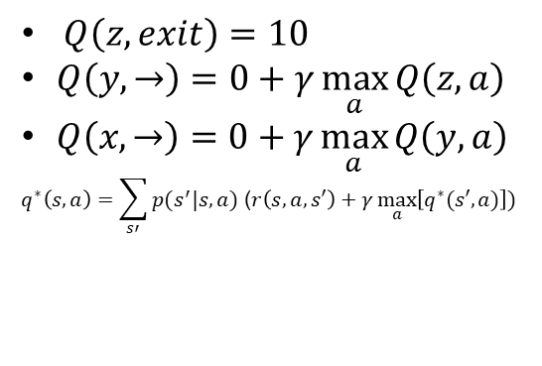
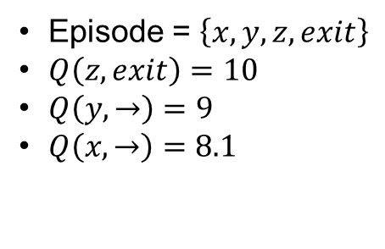



Solving MDPs so far
Dynamic programming
Off policy
local learning, propagating values from neighbors (Bootstrapping)
Model based
Monte-Carlo
On-policy (though important sampling can be used)
Requires a full episode to train on
Model free, online learning
-100
+10
w | x | y | z

Slide 4
Fuse DP and MC
Dynamic programming
Off policy
local learning, propagating values from neighbors (Bootstrapping)
Model based
Monte-Carlo
On-policy (though important sampling can be used)
Requires a full episode to train on
Model free, online learning
TD Learning
Off policy
local learning, propagating values from neighbors (Bootsraping)
Model free, online learning

Slide 5
Temporal difference learning
In Monte-Carlo, G_{t} is an actual return from the complete episode. Now, if we replace G_{t} with an estimated return R(t+1)+V(S_{t+1}), this is what TD(0) would look like:
Where:
R(t+1)+V(S_{t+1}) is called TD target value
R(t+1)+V(S_{t+1})- V(S_{t}）is called TD error.
MC uses accurate return Gt to update value, while TD uses the Bellman Optimality Equation to estimate value, and then updates the estimated value with the target value.

Slide 6
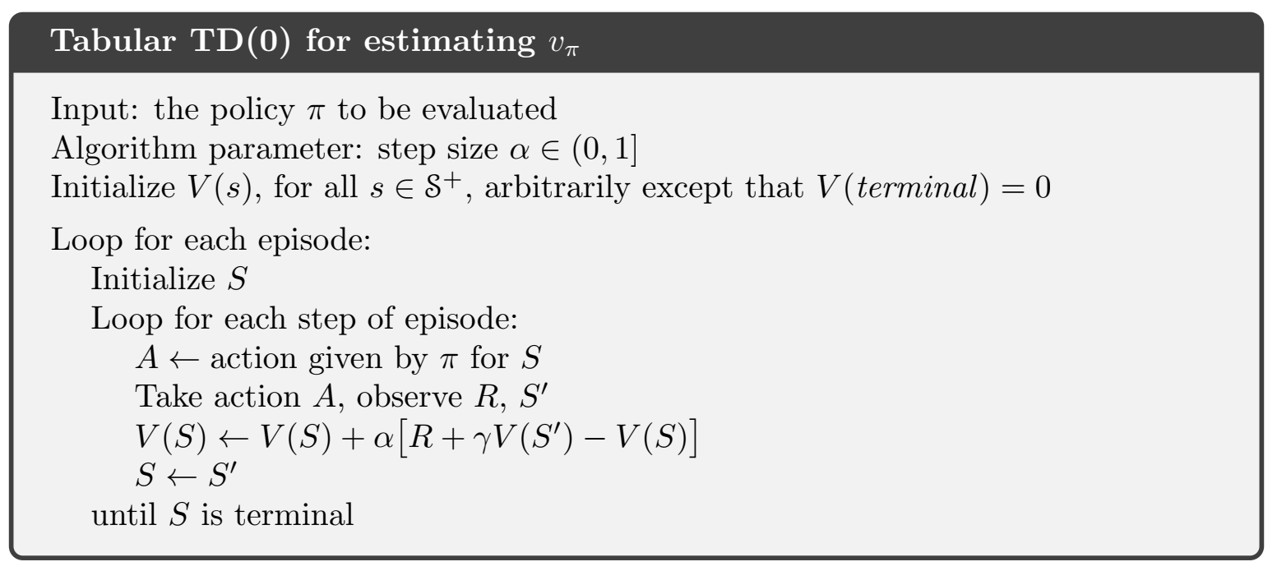
Temporal Difference learning

Slide 7
SARSA: On-policy TD Control
﻿learn an action-value function rather than a state-value function
﻿This update is done after every transition from a nonterminal state S_{t}. If
S_{t+1} is terminal, then Q(S_{t+1}, A_{t+1}) is defined as zero.
﻿Quintuple of events, (S_{t}, A_{t}, R_{t+1}, S_{t+1}, A_{t+1})

Slide 8
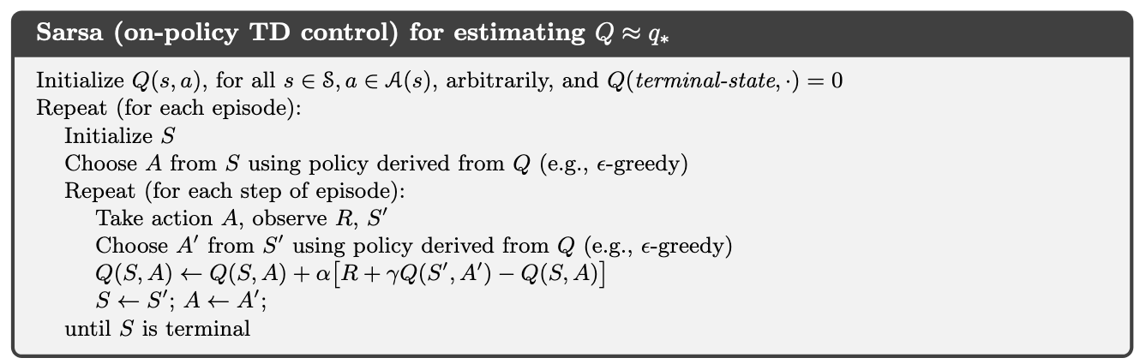

SARSA: On-policy TD Control
$$γ=0.9$$
-100
+10
w | x | y | z

Slide 9
SARSA: On-policy TD Control
$$γ=0.9$$
-100
+10
w | x | y | z
$$Q=$$
0 | 0,0 | 0,0 | 0
w | x | y | z

Slide 10
SARSA: On-policy TD Control
$$γ=0.9$$
-100
+10
w | x | y | z
$$x$$ | $$←$$ | $$0$$ | $$w$$ | $$null$$
S | A | R | S’ | A’
$$Q=$$
0 | 0,0 | 0,0 | 0
w | x | y | z

Slide 11
SARSA: On-policy TD Control
$$γ=0.9$$
-100
+10
w | x | y | z
$$x$$ | $$←$$ | $$0$$ | $$w$$ | $$exit$$
S | A | R | S’ | A’
$$Q=$$
0 | 0,0 | 0,0 | 0
w | x | y | z

Slide 12
SARSA: On-policy TD Control
$$γ=0.9$$
-100
+10
w | x | y | z
$$x$$ | $$←$$ | $$0$$ | $$w$$ | $$exit$$
S | A | R | S’ | A’
$$Q=$$
0 | 0,0 | 0,0 | 0
w | x | y | z

Slide 13
SARSA: On-policy TD Control
$$γ=0.9$$
-100
+10
w | x | y | z
$$w$$ | $$exit$$ | $$0$$ | $$w$$ | $$exit$$
S | A | R | S’ | A’
$$Q=$$
0 | 0,0 | 0,0 | 0
w | x | y | z

Slide 14
SARSA: On-policy TD Control
$$γ=0.9$$
-100
+10
w | x | y | z
$$w$$ | $$exit$$ | $$−100$$ | $$ter$$ | $$exit$$
S | A | R | S’ | A’
$$Q=$$
0 | 0,0 | 0,0 | 0
w | x | y | z

Slide 15
SARSA: On-policy TD Control
$$γ=0.9$$
-100
+10
w | x | y | z
$$w$$ | $$exit$$ | $$−100$$ | $$ter$$ | $$⋅$$
S | A | R | S’ | A’
$$Q=$$
-100 | 0,0 | 0,0 | 0
w | x | y | z

Slide 16
SARSA: On-policy TD Control
$$γ=0.9$$
-100
+10
w | x | y | z
$$x$$ | $$←$$ | $$−100$$ | $$ter$$ | $$⋅$$
S | A | R | S’ | A’
$$Q=$$
-100 | 0,0 | 0,0 | 0
w | x | y | z

Slide 17
SARSA: On-policy TD Control
$$γ=0.9$$
-100
+10
w | x | y | z
$$x$$ | $$←$$ | $$0$$ | $$w$$ | $$exit$$
S | A | R | S’ | A’
$$Q=$$
-100 | 0,0 | 0,0 | 0
w | x | y | z

Slide 18
SARSA: On-policy TD Control
$$γ=0.9$$
-100
+10
w | x | y | z
$$x$$ | $$←$$ | $$0$$ | $$w$$ | $$exit$$
S | A | R | S’ | A’
$$Q=$$
-100 | -90,0 | 0,0 | 0
w | x | y | z

Slide 19
SARSA: On-policy TD Control
And so on…
$$γ=0.9$$
-100
+10
w | x | y | z
$$w$$ | $$exit$$ | $$0$$ | $$w$$ | $$exit$$
S | A | R | S’ | A’
$$Q=$$
-100 | -90,0 | 0,0 | 0
w | x | y | z

Slide 20
Q-learning: Off-policy TD Control
Use the original TD update rule
$Q\left(s,a\right)=Q\left(s,a\right)+α\left(R_{t+1}+γ\max_{a′}\left[Q(s′,a′)\right]−Q\left(s,a\right)\right)$
Approximates the state-action value for the optimal policy, i.e., $q^{∗}$
Assuming that every state-action pair is visited infinitely often
Follows from the proof of convergence for the Bellman function
See slides MDPs+DP

Slide 21
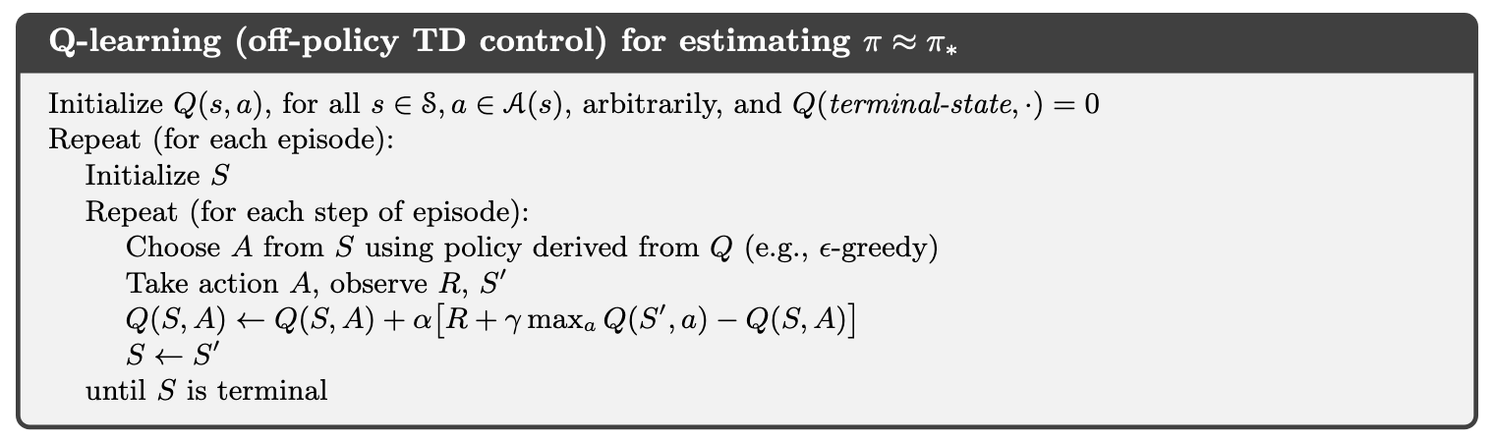
Q-learning: Off-policy TD Control
$$γ=0.9$$
+10
-100
w | x | y | z
$$x$$ | $$null$$ | $$null$$ | $$null$$
S | A | R | S’
$$Q=$$
0 | 0,0 | 0,0 | 0
w | x | y | z

Slide 22
Q-learning: Off-policy TD Control
$$γ=0.9$$
+10
-100
w | x | y | z
$$x$$ | $$→$$ | $$0$$ | $$y$$
S | A | R | S’
$$Q=$$
0 | 0,0 | 0,0 | 0
w | x | y | z

Slide 23
Q-learning: Off-policy TD Control
$$γ=0.9$$
+10
-100
w | x | y | z
$$x$$ | $$→$$ | $$0$$ | $$y$$
S | A | R | S’
$$Q=$$
0 | 0,0 | 0,0 | 0
w | x | y | z

Slide 24
Q-learning: Off-policy TD Control
$$γ=0.9$$
+10
-100
w | x | y | z
$$y$$ | $$→$$ | $$0$$ | $$y$$
S | A | R | S’
$$Q=$$
0 | 0,0 | 0,0 | 0
w | x | y | z

Slide 25
Q-learning: Off-policy TD Control
$$γ=0.9$$
+10
-100
w | x | y | z
$$y$$ | $$→$$ | $$0$$ | $$z$$
S | A | R | S’
$$Q=$$
0 | 0,0 | 0,0 | 0
w | x | y | z

Slide 26
Q-learning: Off-policy TD Control
$$γ=0.9$$
+10
-100
w | x | y | z
$$z$$ | $$→$$ | $$0$$ | $$z$$
S | A | R | S’
$$Q=$$
0 | 0,0 | 0,0 | 0
w | x | y | z

Slide 27
Q-learning: Off-policy TD Control
$$γ=0.9$$
+10
-100
w | x | y | z
$$z$$ | $$exit$$ | $$−100$$ | $$⋅$$
S | A | R | S’
$$Q=$$
0 | 0,0 | 0,0 | 0
w | x | y | z

Slide 28
Q-learning: Off-policy TD Control
$$γ=0.9$$
+10
-100
w | x | y | z
$$z$$ | $$exit$$ | $$−100$$ | $$⋅$$
S | A | R | S’
$$Q=$$
0 | 0,0 | 0,0 | -100
w | x | y | z

Slide 29
Q-learning: Off-policy TD Control
$$γ=0.9$$
+10
-100
w | x | y | z
$$x$$ | $$exit$$ | $$−100$$ | $$⋅$$
S | A | R | S’
$$Q=$$
0 | 0,0 | 0,0 | -100
w | x | y | z

Slide 30
Q-learning: Off-policy TD Control
$$γ=0.9$$
+10
-100
w | x | y | z
$$x$$ | $$→$$ | $$0$$ | $$y$$
S | A | R | S’
$$Q=$$
0 | 0,0 | 0,0 | -100
w | x | y | z

Slide 31
Q-learning: Off-policy TD Control
$$γ=0.9$$
+10
-100
w | x | y | z
$$y$$ | $$→$$ | $$0$$ | $$z$$
S | A | R | S’
$$Q=$$
0 | 0,0 | 0,0 | -100
w | x | y | z

Slide 32
Q-learning: Off-policy TD Control
$$γ=0.9$$
+10
-100
w | x | y | z
$$y$$ | $$→$$ | $$0$$ | $$z$$
S | A | R | S’
$$Q=$$
0 | 0,0 | 0,-90 | -100
w | x | y | z

Slide 33
Q-learning: Off-policy TD Control
$$γ=0.9$$
+10
-100
w | x | y | z
$$x$$ | $$→$$ | $$0$$ | $$z$$
S | A | R | S’
$$Q=$$
0 | 0,0 | 0,-90 | -100
w | x | y | z

Slide 34
Q-learning: Off-policy TD Control
$$γ=0.9$$
+10
-100
w | x | y | z
$$x$$ | $$→$$ | $$0$$ | $$y$$
S | A | R | S’
$$Q=$$
0 | 0,0 | 0,-90 | -100
w | x | y | z

Slide 35
Q-learning: Off-policy TD Control
$$γ=0.9$$
+10
-100
w | x | y | z
$$x$$ | $$→$$ | $$0$$ | $$y$$
S | A | R | S’
$$Q=$$
0 | 0,0 | 0,-90 | -100
w | x | y | z

Slide 36
Q-learning: Off-policy TD Control
And so on…
$$γ=0.9$$
+10
-100
w | x | y | z
$$x$$ | $$→$$ | $$0$$ | $$y$$
S | A | R | S’
$$Q=$$
0 | 0,0 | 0,-90 | -100
w | x | y | z

Slide 37
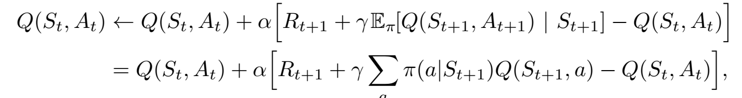
Expected SARSA
﻿Instead of the maximum over next state–action pairs it uses the expected value, taking into account how likely each action is under the current policy

Slide 38
Maximization Bias & Double Learning
﻿Maximum over estimated values is used implicitly as an estimate of the
maximum value, which can lead to a significant positive bias.
Solution – Learn two estimates – Double Learning
﻿Double learning doubles the memory requirements, but does not
increase the amount of computation per step.

Slide 39
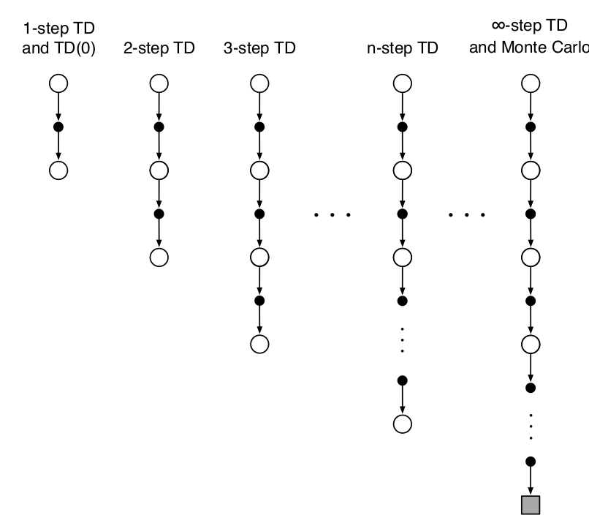


n-step TD Prediction
One-step return:
Two-step return:
Ref Section 7.1 of TB

Slide 40
n-step TD Prediction
One-step return:
Two-step return:
n-step return:
Ref Section 7.1 of TB

Slide 41
n-step TD Prediction
One-step return:
Two-step return:
n-step return:
State-value learning algorithm for using n-step returns:
Ref Section 7.1 of TB

Slide 42
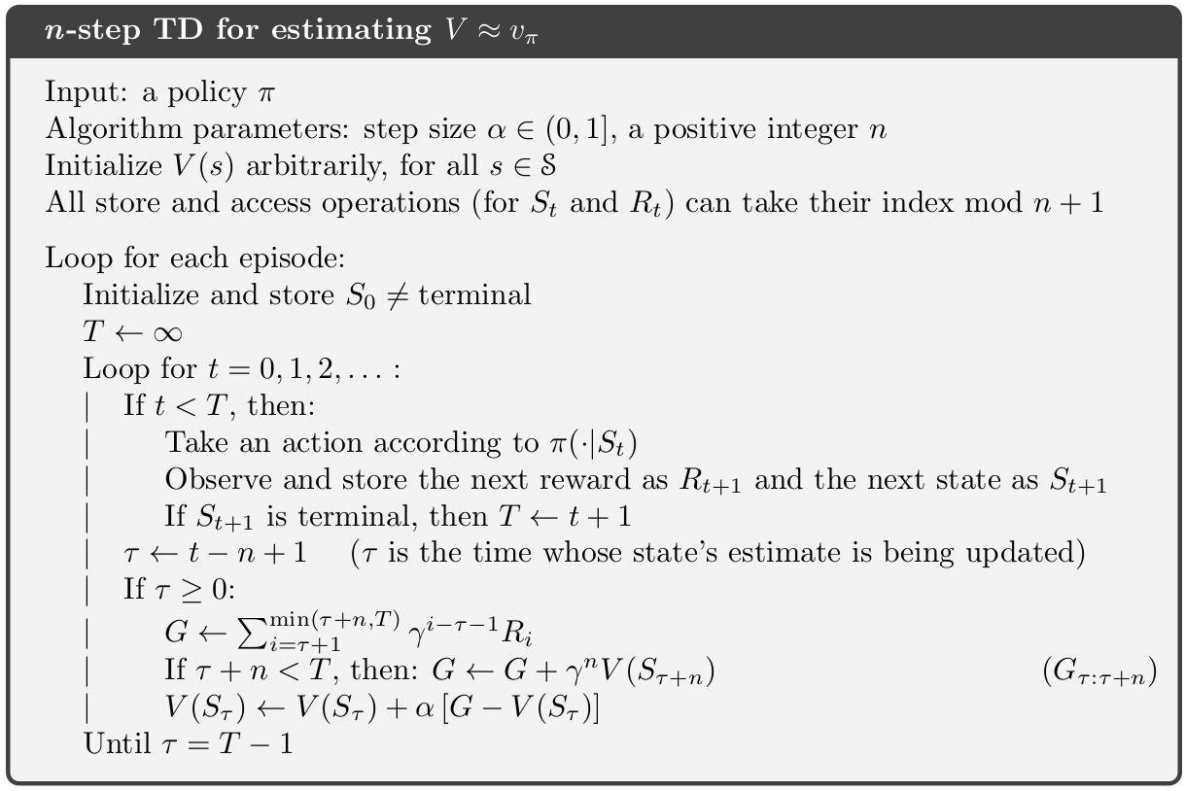
n-step TD Prediction

Slide 43
Required Readings
Chapter-6 of Introduction to Reinforcement Learning,2nd Ed., Sutton & Barto

Slide 44
Thank you

